Slide 1
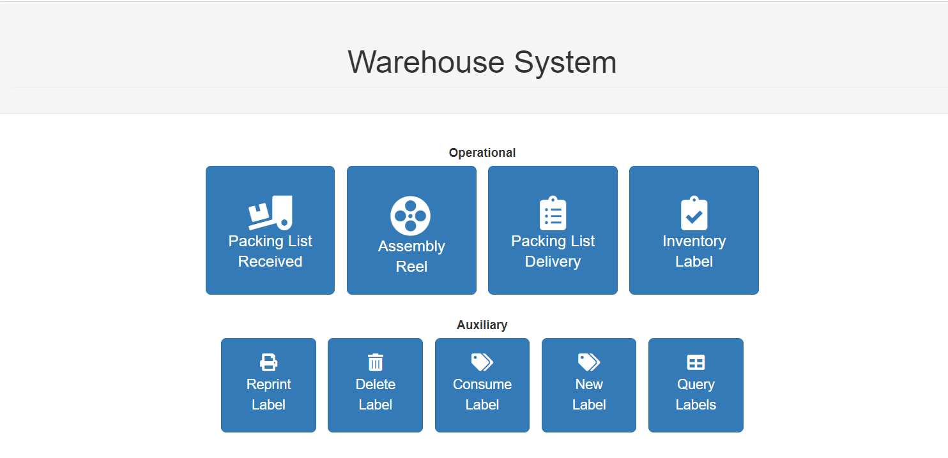
Warehouse System Operational manual for stock control

Slide 2
Operational
These are routines used for receiving, processing, delivering stock material as well controling available for inventory purposes .

Slide 3
Packing List Received
When use?
When you receive a transfer packinglist by Tarboro or other warehouse and purchase (importation) from reels

Slide 4
Packing List Received
How to use?
Take collector and scan the labels from material received
Copy and save the file on your computer (C:\\Coletor)

Slide 5
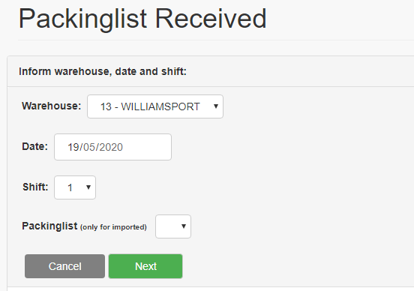
Packing List Received
How to use?
Here the system shows the warehouse selected and current day and shift.
Usually the date field is not changed unless cargo is
received in diferente day than the date you are entering
data in the system.
If you are receiving imported reels, inform in the
Packing list field the number of the imported packing list
you are receiving. The reason for this is because the
fractioned receipt of invoices from Brazil

Slide 6
Packing List Received
How to use?
Here you have to choose the File from the scanning process during the cargo offloading.
Note that this data from the scanner will be compared to the packing slip data and it will show discrepancies if any for further actions.

Slide 7
Packing List Received
How to use?
Open the folder Coletor on your (C:\\) and select the file
Later click in Next

Slide 8
Packing List Received
How to use?
Here the file is displayed
If all are ok the status will be green
If something is wrong, the system will show red message
By clicking in the “Attention” message you may have to take an action to solve it and keep working in this function.

Slide 9
Packing List Received
Continue without Label
Continue the proccess ignoring the missing labels
Print manually label
Another window open and you can print the labels missing ( Ex. Labels get lost during transportation)
Abort proccess
You cancel the proccess and scan the labels again / or uplod previous file again

Slide 10
Assembly Reel
When use?
This routine it’s used when you we will convert drums from kit form into assembled reel.

Slide 11
Assembly reel
How to use
First you select if are a Individual ou From collector choise
Individual
When you have one bundle for assembling
From Collector
When you have multiple bundles to be assembled

Slide 12
Assembly reel
How to use?
If you select Individual
Enter the label number
Click on Confirm

Slide 13
Assembly reel
Inform the qty assmbled.
After that go to the PRINT LABEL field, select if you want to generate INDIVIDUAL LABEL to get as many labels as the number of reels assembled or ONLY ONE LABEL to generate one single label representing the group of reels assembled.
Ex: If you want assembly 5 kits, put 5 kits on QTY ASSEMBLED
Choise “Individual label”, it will make one label for each kit ( 5 Labels)
If you choise “Only one label”, it will make one single label for all the kits
If you don’t comsume whole label quantity, the system generate new label contending the balance which remains unassembled.
Click in Confirm

Slide 14
Assembly reel
How to use?
If you select From Collector
You choose the file
Confirm the date of assembly
Click in Upload

Slide 15
Assembly reel
Here it will shows all labels scanned and will make one label contending all reels from diferent labels.

Slide 16
Packing List Delivery
When use?
When you have to proceed the truck loading ( Goods to be delivered to the customer / transfers from one location to the other ( warehouse to warehouse ), etc...

Slide 17
Packing List Delivery
How to use?
Here you have to choose the File from the scanning process during the cargo loading.

Slide 18
Packing List Delivery
How to use?
Here we will make a link with customers and PO existent in the system
Select customer that will receive the loading as well PO number;
Click on find and system will display qtys available in the inventory;

Slide 19
Packing List Delivery
Here you may get the information from all goods loaded x stocks availability ( just for information)
If QTY REEL matches the qty loaded just press “SUBMIT”

Slide 20
Inventory Label
When use?
This a routine to be used when we are running a stock check in order to keep iventory correct in the system.

Slide 21
Inventory Label
How to use?
Here you have to choose the File from all labels scanned from the material available in the warehouse.
It is essencial to assure that all labels have been scanned properlly from existent stock available in the warehouse.
Also it’s recomended to run stock check when we have NO operations going on at the warehouse to avoid discrepancies from missing data as well there is no pendencies from pending PL/invoices to be registered, etc... The main purpose here is to check if physicall matches the system.

Slide 22
Inventory Label
Next step is selecting the inventory date in order to reflect the actual scenario we are evaluating.

Slide 23
Inventory Label
After that you have to select NEW IMPORT and click YES if you want system runs the inventory routine considering only one file with data colected or *NO if you want system considering multiples files to be consolidate together.
* NO option it’s selected if the data scanning process is conducing in separate steps/ shifts or days ( not at one running ). In this case system will considered multiples files from coletor to consolidate at one report.

Slide 24
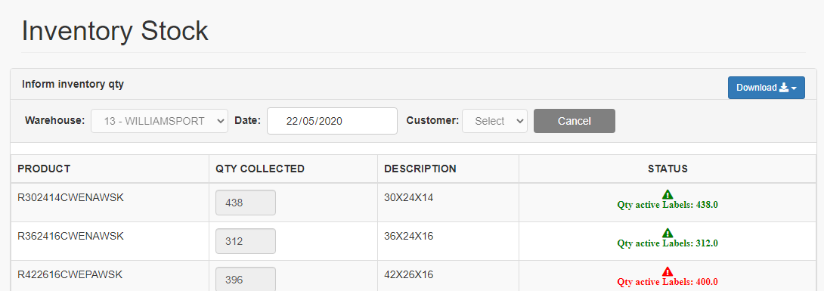
Inventory Label
Here finally you will get a report comparing the qty scanned x qty available i the system.
If all STATUS become green indicating that qtys in the system matches qty scanned just click in “Submit”
If STATUS shows any discrepancy in any line ( red ) its recomended to go and check physically this item to assure the problem prior to run and request for manual stock adjustment ( IT ticket)
Click on the download button to see in excel sheet a complete and detailed report of the readings and their status

Slide 25
Auxiliary
These are some additional tools / functions to support the main routines of this program.

Slide 26
Reprint Label
When use?
When you know the label number and want to print it again for some reason ( Bar code gets spoiled / damaged or missig label.
** In this tool you are not adding or consuming inventory in the system

Slide 27
Reprint Label
How to use?
Enter the label number in the field and click GENERATE
Label it will be displayed in the screen. If all is ok just press PRINT.

Slide 28
Delete Label
When use?
Usually used when you are running some test, printer setting or get a label spoiled during printing and wishes to delete it to not include or consume items from stock.

Slide 29
Delete Label
How to use?
Select the Date, inform label number and click FIND.
Once label is displayed just press DELETE to execute the task.

Slide 30
Consume Label
When use?
This is an option for running eventually ( ex: when we have packing lists made in manual way). If the OPERATIONAL routines are executed in a proper way, the system automatically will consume the labels ( ex: transformig kits into reels)
Other possible usage of this tool is for defective/rejected reels received from factory ( Tarboro, Brazil, ..)

Slide 31
Consume Label
How to use
First you select Individual, From collector or Inform Defect
Individual
When you have one bundle for consuming
From Collector
When you have multiple bundles for consuming
Inform Defect
When you have received some reel with quality problem (non conformity)

Slide 32
Consume Label
If you select Individual
Enter the date, label number and feature ( *Assembly / Delivery / Error )
*Assembly : When is a label from assembled products
* Delivery: When is a label from delivered products
* Error: if there is any information wrong in the label

Slide 33
Consume Label
Here you make the check over the label information. After that clicks CONSUME.

Slide 34
Consume Label
If you select From Collector
You choose the file
Confirm the date
Confirm shift ( optional)
Confirm Feature
Assembly
When is a label from assembled products
Delivery
When is a label from delivered products

Slide 35
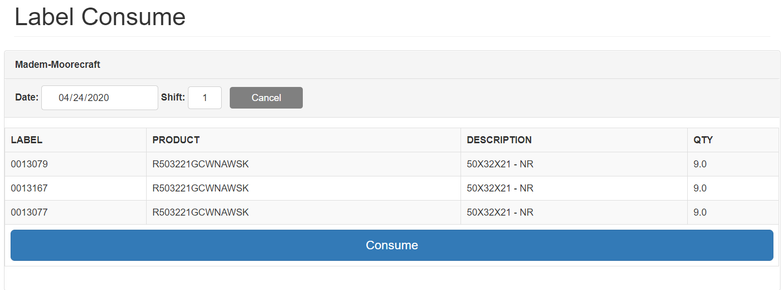
Consume Label
Here you just check all and click on Consume

Slide 36
Consume Label
If you select Inform defect
Inform label number and click Confirm

Slide 37
Consume Label
Inform the quantity of defective reels
Select the reason of the problem and include some observation
Click in Confirm to consume this label
* Note that when you usually use thus option Inform Defect to consume a label possible after that you may create new labels for this package to sort out kits without problem and defective ones.

Slide 38
New Label
When use?
When you have to create a new label manually for the product

Slide 39
New Label
How to use?
Inform the Product Code
Number of copy required for this Label
And also the quantity fo the Reels for this package

Slide 40
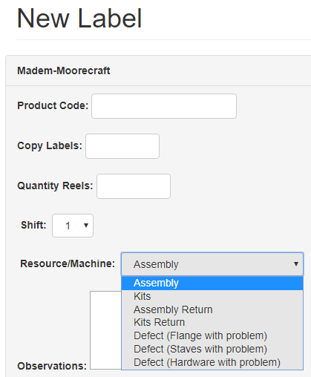
New Label
How to use?
Select the Resource/Machine to inform the status of the material:
Assembly: When is a label for assembled products
Kits: When is a label for unassembled products
Assembly /Kits return : When you want to return one assembled reel or kit
Defective: When you want to generate a label for a defect product.

Slide 41
New Label
Observations can be included
Click Confirm

Slide 42
Query Labels
When use?
When you want to make a consulting from some label
It generates reports from the labels available in stock

Slide 43
Query Labels
How to use?
Select the status of the label required or you can select all.

Slide 44
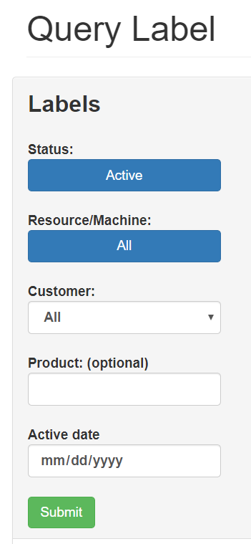
Query Labels
From ACTIVE labels you can sort the assembled / delivered / errors ... From Resource/machine option
Also sorting by customer / specific product / active date

Slide 45
Query Labels
Report it’s generated from the filters / selection done.

